Slide 1
HTTP Bridge
Chatchai Kongmanee
Specialist Solution Architect
Red Hat, Thailand

Slide 2
HTTP Bridge
Allows to producer and consumer Kafka messages using HTTP protocol / REST API
Available on RHEL and OCP
On RHEL as a ZIP download
On OCP deployed through the operator using KafkaBridge custom resource
Allows to consumer and produce JSON and binary messages
JSON messages can be consumed and produced directly
Everything else has to be sent as Binary
Payloads are Base64 encoded
Can cover actual binary data but also things such as Strings etc.

Slide 3
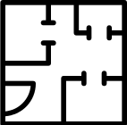






HTTP Bridge
KafkaBridge CR
Kafka CR
HTTP

Slide 4
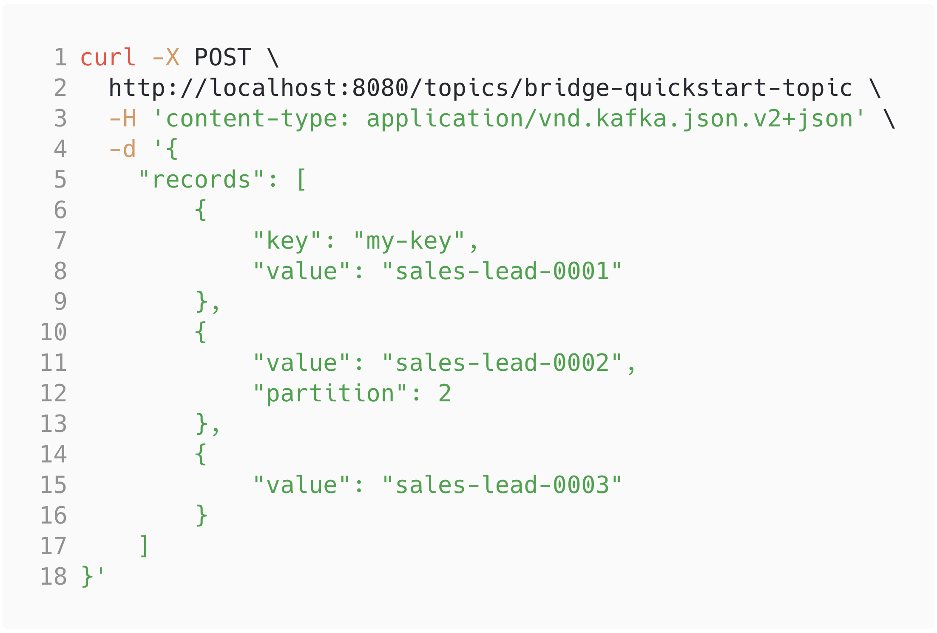
Producers
POST to the right URI
URI /topics/<topic-name>
Content-type headers are important
Multiple messages in one request

Slide 5
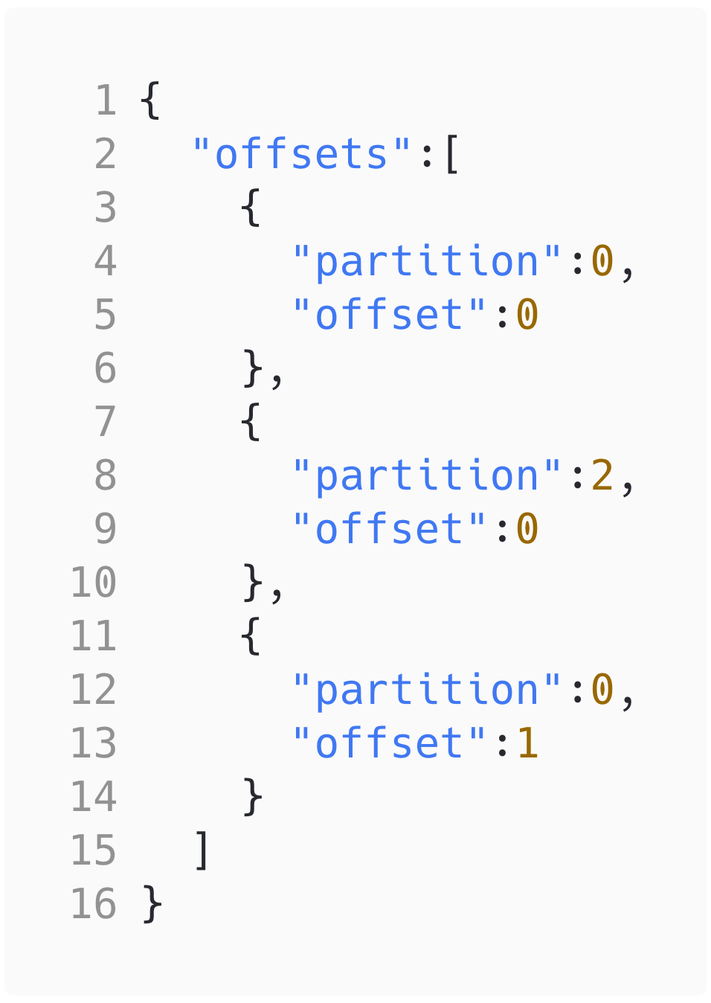
Producers
POST Response
JSON with the partitions and offsets

Slide 6
Consumers
Consumers are stateful
Create a consumer
Subscribe it to topics
Consume messages
Close the consumer
Statefulness is needed to handle performance, consumer groups, rebalances etc.
Makes scaling complicated

Slide 7
Consumers
Create a consumer instance
Subscribe to topics
Poll for messages
Commit messages
Close consumer

Slide 8
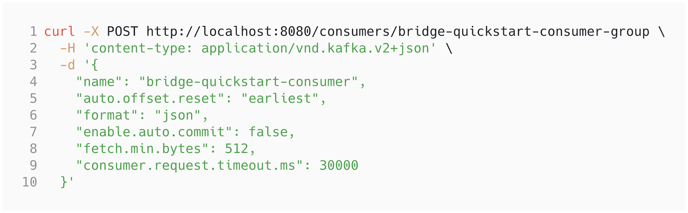
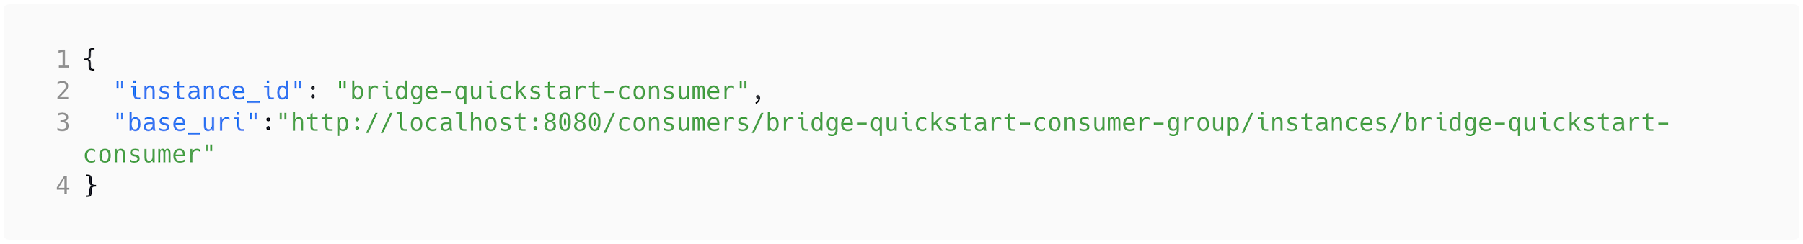
Create consumer

Slide 9
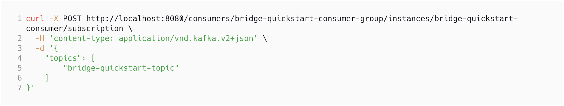
Subscribe consumer

Slide 10
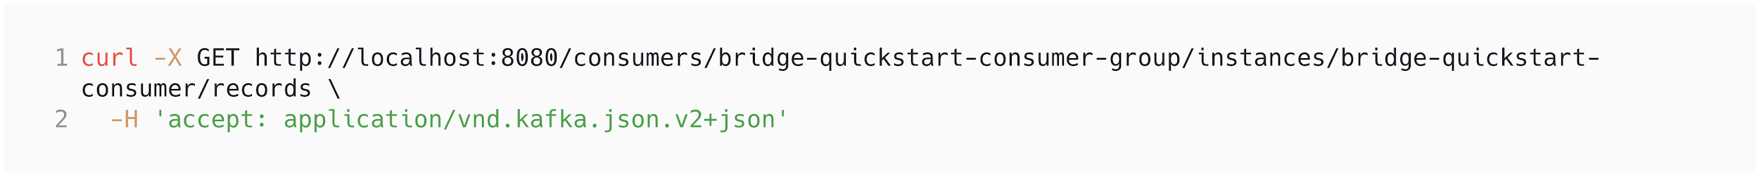
Poll for messages

Slide 11
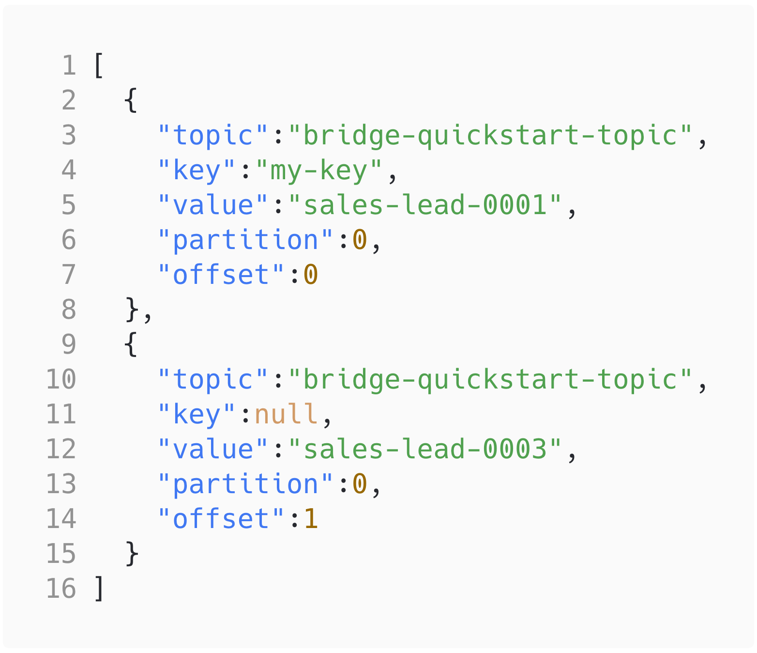
Poll for messages

Slide 12
Commit

Slide 13
Scalability
The HTTP Bridge consumers follow the consumer group principles
When consumer with given consumer group is created, it is assigned set or partitions to consume
When the consumer exists on multiple instances, all of them need to be polled for messages
Alternatives
To deploy many bridges in parallel each for different application
Run the bridge as sidecar in the application pod
No limitations to producer scalability

Slide 14

Scalability
CG1
Topic
Partition 0
CG1
Partition 1
Partition 2
CG1

Slide 15
Scalability
CG1
Topic
Partition 0
CG1
Partition 1
Partition 2
CG1

Slide 16

Scalability
CG1
Topic
CG1
Partition 0
CG1

Slide 17
Security
HTTP and Kafka identities are currently separate
Kafka
Has its own identity
Usual mechanisms are supported
TLS encryption, TLS Auth, SASL Auth
HTTP
3rd party solutions can be used
API Gateways (3scale), OAuth proxies, network policies
More security features planned in the future

Slide 18
Thank you

